Slide 1


The Differentiable Cross-Entropy Method
Brandon Amos¹ Denis Yarats¹²
¹Facebook AI Research ²New York University
ICML 2020
brandondamos
denisyarats
bamos.github.io
cs.nyu.edu/~dy1042

Slide 2
The cross-entropy method is a powerful optimizer
Iterative sampling-based optimizer that:
1. Samples from the domain 2. Observes the function’s values 3. Updates the sampling distribution Widely used in control and model-based RL

Slide 3
Problem: CEM breaks end-to-end learning
A common learning pipeline, e.g. for control, is
1. Fit models with maximum likelihood 2. Run CEM on top of the learned models 3. Hope CEM induces reasonable downstream performance
Objective mismatch issue: models are unaware of downstream performance

Slide 4
The Differentiable Cross-Entropy Method (DCEM)
Differentiate backwards through the sequence of samples Using differentiable top-k (LML) and reparameterization
Useful when a fixed point is hard to find, or when unrolling gradient descent hits a local optimum
A differentiable controller in the RL setting

Slide 5
This Talk
Method: The differentiable-cross entropy method
Applications Learning deep energy-based models Learning embedded optimizers Control

Slide 6
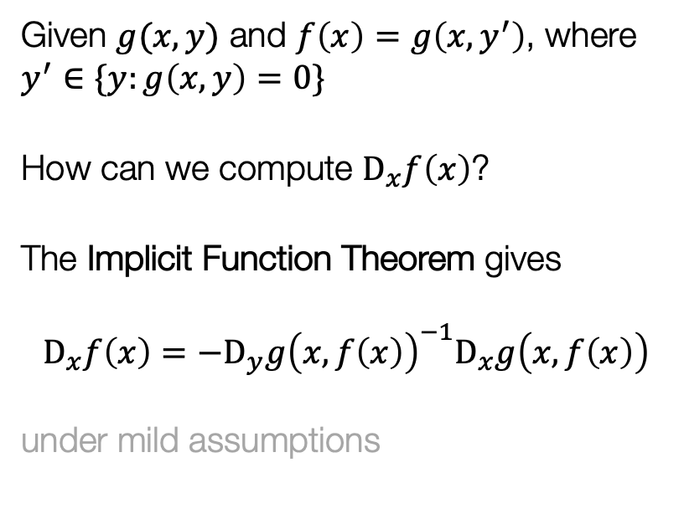


Foundation: The Implicit Function Theorem
[Dini 1877, Dontchev and Rockafellar 2009]
Given $g(x,y)$ and $f\left(x\right)=g\left(x,y^{′}\right)$, where $y^{′}∈\{y:g\left(x,y\right)=0\}$
How can we compute $D_{x}f\left(x\right)$?
The Implicit Function Theorem gives $$D_{x}f\left(x\right)=−D_{y}g{\left(x,f\left(x\right)\right)}^{−1}D_{x}g\left(x, f\left(x\right)\right)$$ under mild assumptions
$$D_{x}g(x, f\left(x\right))$$
$$D_{y}g(x, f\left(x\right))$$

Slide 7
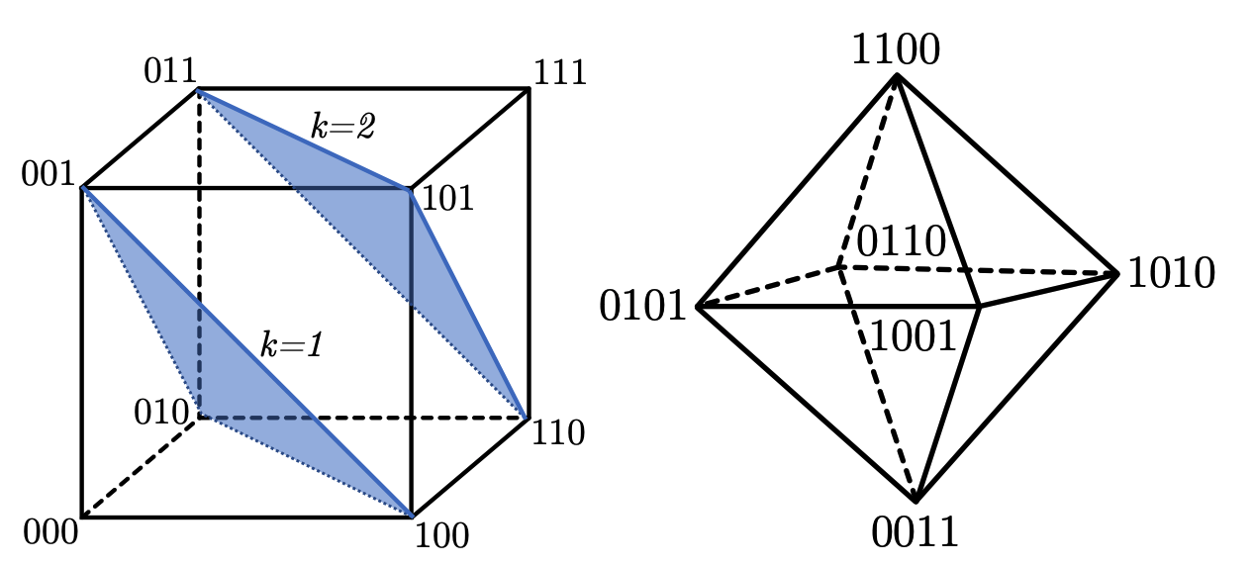
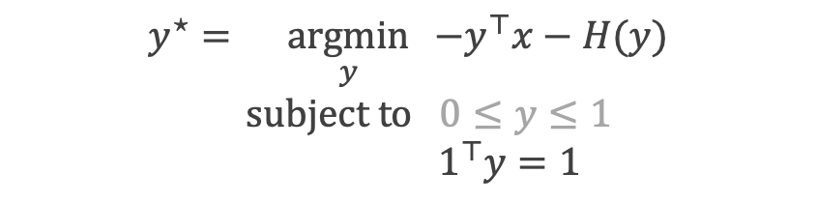
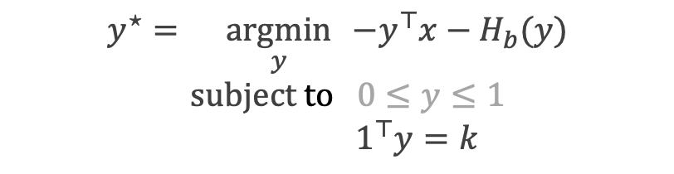
Foundation: Differentiable top-k operations
[Constrained softmax, constrained sparsemax, Limited Multi-Label Projection]
Optimization perspective of the softmax
Limited Multi-Label Projection
$$y^{⋆}=\underset{y}{argmin}{ −y^{⊤}x−H(y)} \\ \text{subject} \text{to} 0≤y≤1$$
$$1^{⊤}y=1$$
$$y^{⋆}=\underset{y}{argmin}{ −y^{⊤}x−H_{b}(y)} \\ \text{subject} \text{to} 0≤y≤1$$
$$1^{⊤}y=k$$

Slide 8
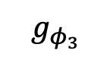
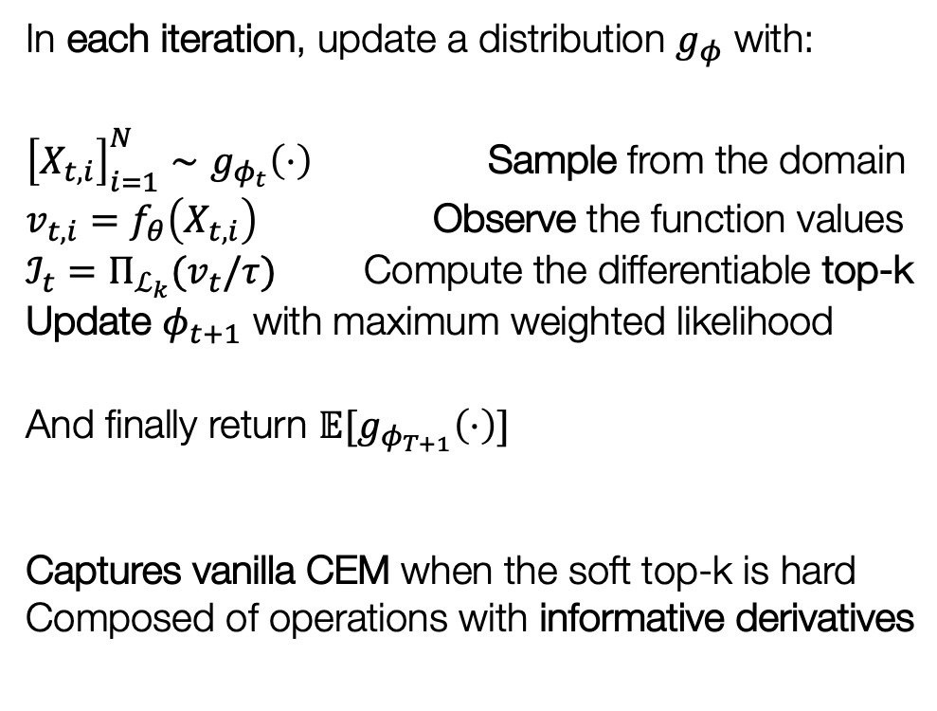
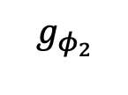
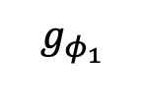
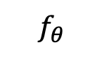
The Differentiable Cross-Entropy Method
In each iteration, update a distribution $g_{φ}$ with:
${\left[X_{t,i}\right]}_{i=1}^{N}∼g_{φ_{t}}\left(⋅\right)$ Sample from the domain $v_{t,i}=f_{θ}\left(X_{t,i}\right)$ Observe the function values $ℐ_{t}=Π_{ℒ_{k}}(v_{t}/τ)$ Compute the differentiable top-k Update $φ_{t+1}$ with maximum weighted likelihood
And finally return $𝔼[g_{φ_{T+1}}\left(⋅\right)]$ Captures vanilla CEM when the soft top-k is hard Composed of operations with informative derivatives
$$f_{θ}$$
$$g_{φ_{3}}$$
$$g_{φ_{2}}$$
$$g_{φ_{1}}$$

Slide 9
This Talk
Method: The differentiable-cross entropy method
Applications Learning deep energy-based models Learning embedded optimizers Control

Slide 10
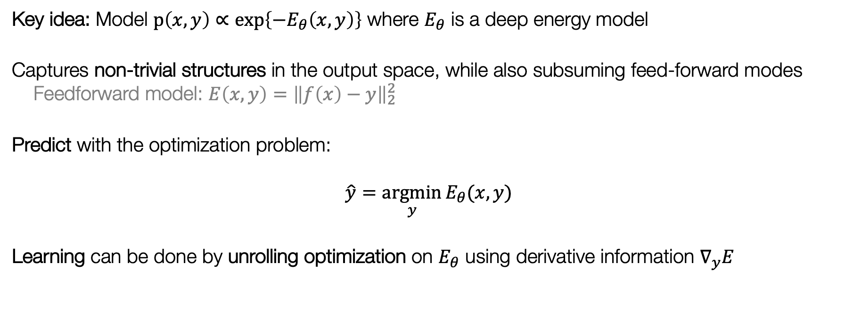
Deep Structured Energy Models (SPENs/ICNNs)
[Belanger and McCallum, 2016, Amos, Xu, and Kolter, 2017]
Key idea: Model $p\left(x,y\right)∝\exp\left\{−E_{θ}\left(x,y\right)\right\}$ where $E_{θ}$ is a deep energy model
Captures non-trivial structures in the output space, while also subsuming feed-forward modes Feedforward model: $E\left(x,y\right)={\left\|f\left(x\right)−y\right\|}_{2}^{2}$
Predict with the optimization problem:
$$\hat{y}=\underset{y}{argmin}{E_{θ}(x,y)}$$
Learning can be done by unrolling optimization on $E_{θ}$ using derivative information $∇_{y}E$

Slide 11
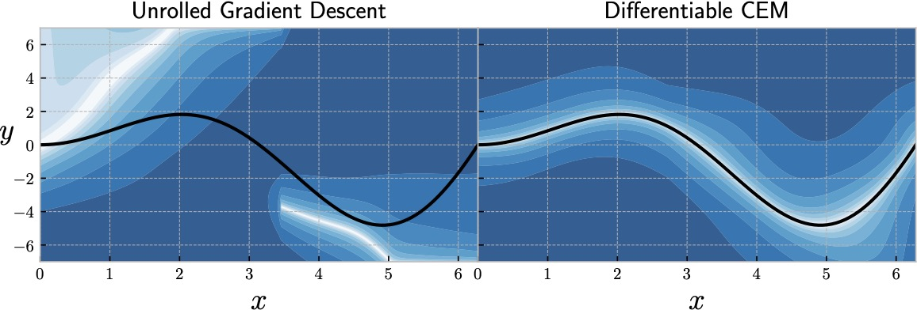
Unrolling gradient descent may learn bad energies
Unrolling optimizers lose the probabilistic interpretation and can overfit to the optimizer
In this regression setting, GD learns barriers on the energy surface while DCEM fits the data

Slide 12
This Talk
Method: The differentiable-cross entropy method
Applications Learning deep energy-based models Learning embedded optimizers Control

Slide 13
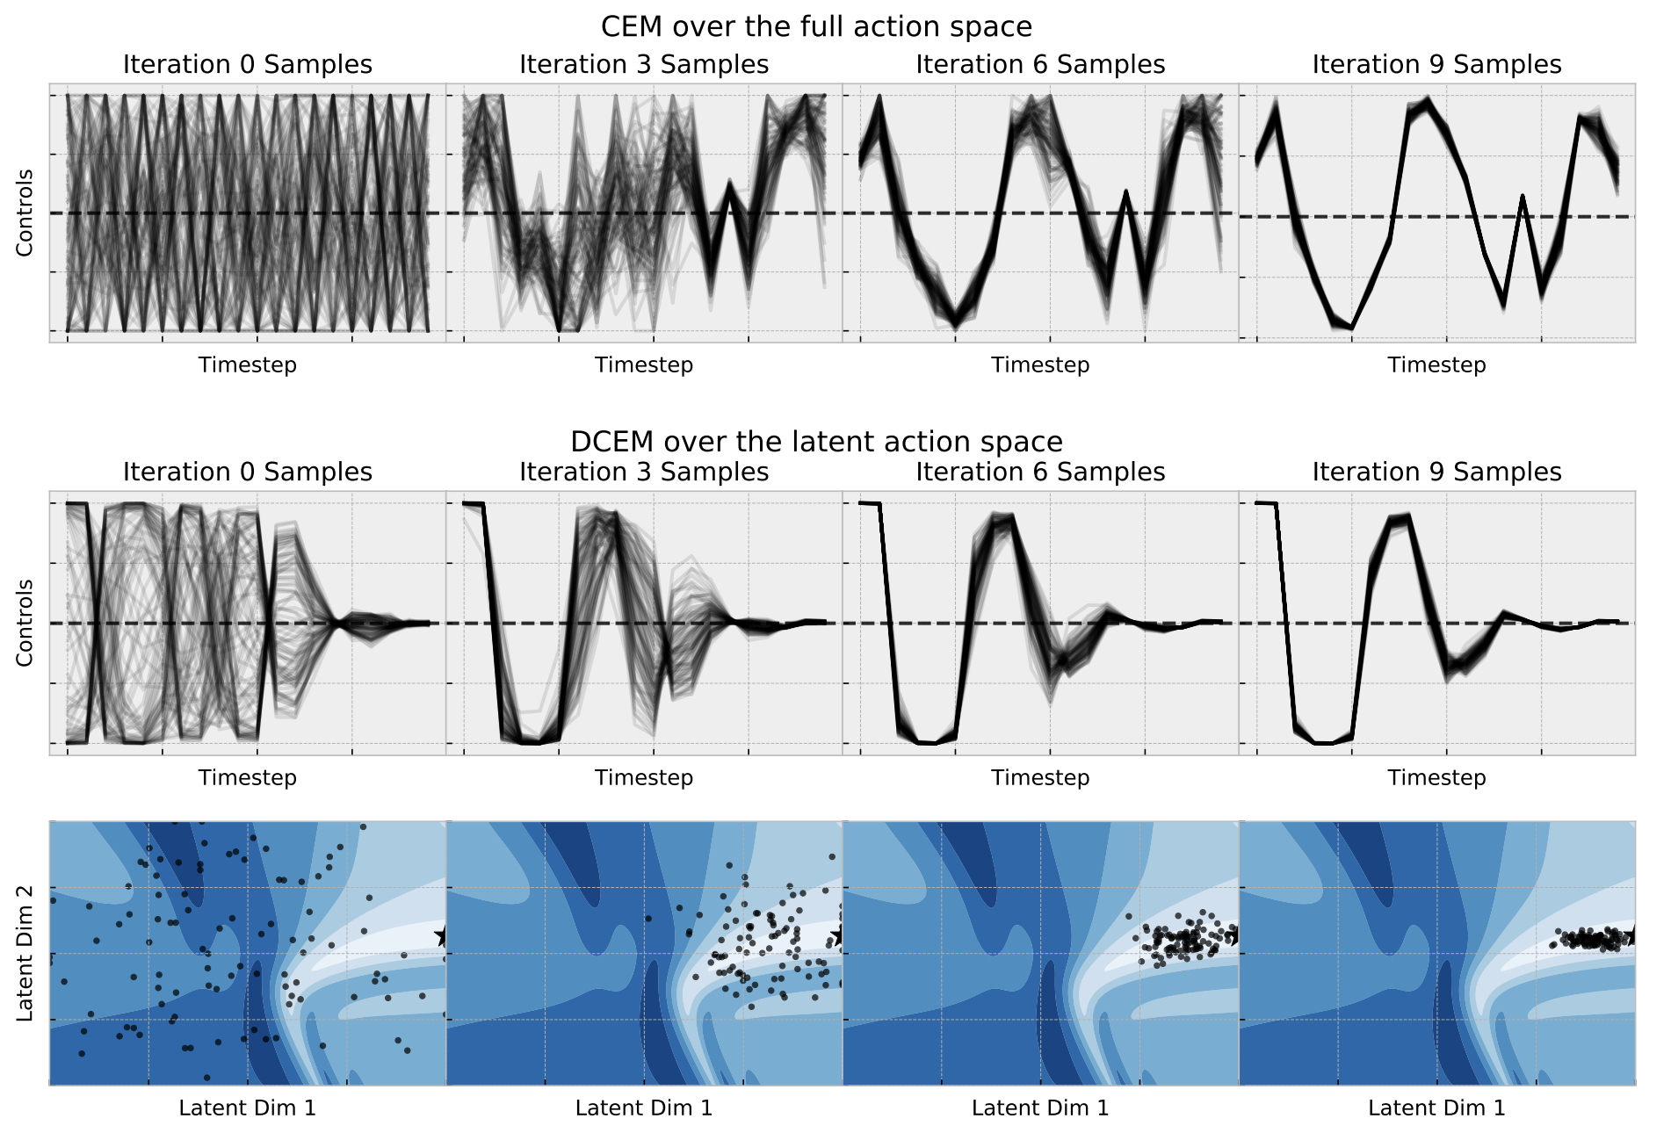

DCEM can exploit the solution space structure
$$x^{⋆}=\underset{x∈{\left[0,1\right]}^{N}}{argmin}{f\left(x\right)}$$
Full Domain
Manifold of Optimal Solutions
Latent Manifold of Optimal Solutions

Slide 14
This Talk
Method: The differentiable-cross entropy method
Applications Learning deep energy-based models Learning embedded optimizers Control

Slide 15
Should RL policies have a system dynamics model or not?
Policy
Neural Network(s)
State
Action
System Dynamics
Future Plan
Model-free RL
More general, doesn’t make as many assumptions about the world
Rife with poor data efficiency and learning stability issues
Model-based RL (or control)
A useful prior on the world if it lies within your set of assumptions

Slide 16
Model Predictive Control
Known or learned from data

Slide 17
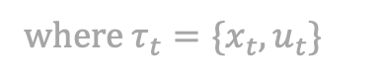
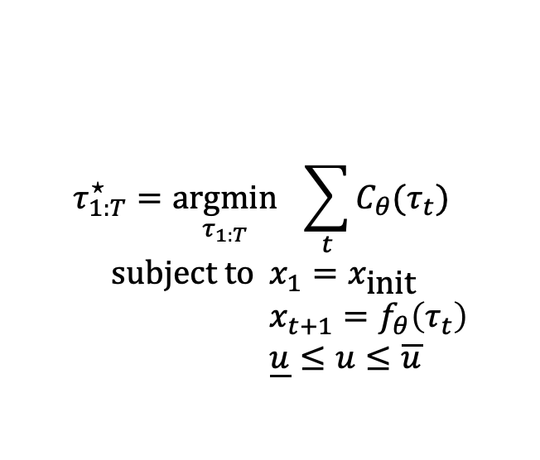
Differentiable Control via DCEM
A pure planning problem given (potentially non-convex) cost and dynamics:
$$τ_{1:T}^{⋆}=\underset{τ_{1:T}}{argmin}{ \sum_{t}{C_{θ}(τ_{t})}} \\ \text{subject} \text{to} x_{1}=x_{\text{init}} \\ x_{t+1}=f_{θ}\left(τ_{t}\right) \\ \underline{u}≤u≤\overline{u}$$
Cost
Dynamics
where $τ_{t}=\{x_{t}, u_{t}\}$
Idea: Solve this optimization problem with DCEM and differentiate through it

Slide 18
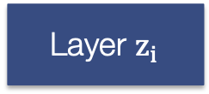
Differentiable Control via DCEM
A lot of data
Model
Predictions
Loss
…
Layer $z_{i}$
DCEM
…
What can we do with this now?
Augment neural network policies in model-free algorithms with MPC policies Fight objective mismatch by end-to-end learning dynamics The cost can also be end-to-end learned! No longer need to hard-code in values Caveat: Control problems are often intractably high-dimensional, so we use embedded DCEM

Slide 19
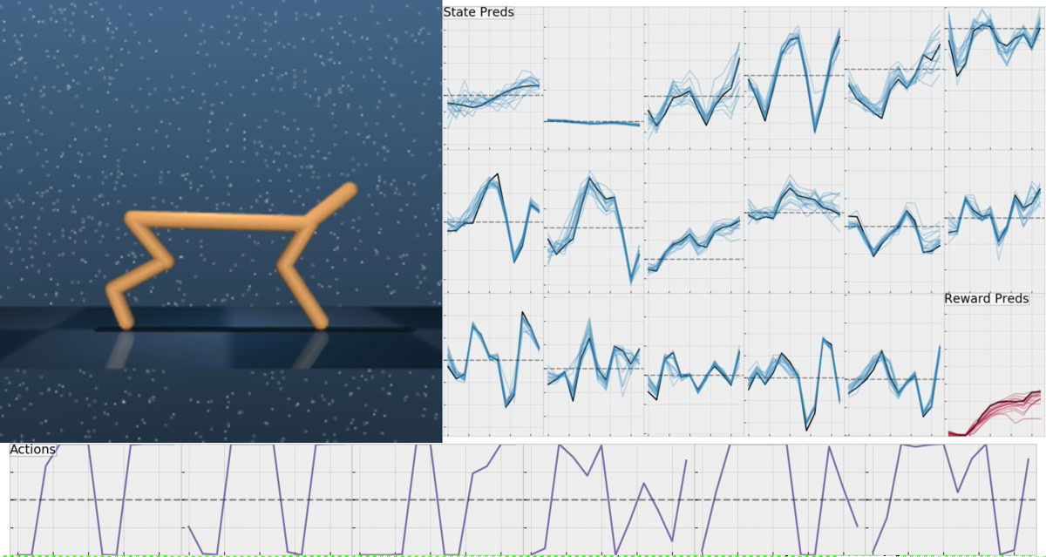
DCEM fine-tunes highly non-convex controllers
sites.google.com/view/diff-cross-entropy-method

Slide 20
The Differentiable Cross-Entropy Method
Brandon Amos¹ Denis Yarats¹²
¹Facebook AI Research ²New York University
ICML 2020
brandondamos
denisyarats
bamos.github.io
cs.nyu.edu/~dy1042

